Slide 1

AI-Powered Self-Healing Security
Autonomous threat detection, response, and recovery.
Key Capabilities
Automated Response: AI-driven risk scoring, rate limiting, firewall updates.
Adaptive Policies: Reinforcement learning, Bayesian/genetic optimization.
Self-Healing: Fault-tolerant device restoration, firmware rollback.
Scenario Testing: Simulating attacks to measure resilience, recovery.

Slide 2

Problem Statement & Challenges
Cyber Threat Sophistication
Lack of Adaptability
Manual Response Delays
Increasingly advanced attacks bypass legacy security.
Traditional systems struggle to evolve.
Human intervention slows incident response.

Slide 3
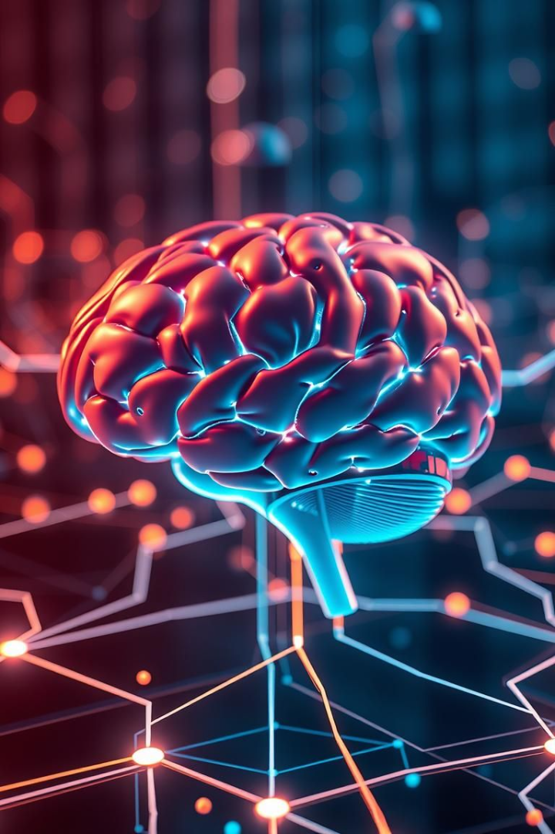




AI-Driven Security Framework
AI-Driven IDS
Real-time intrusion detection powered by AI.
Adaptive Policies
Reinforcement learning for policy optimization.
Threat Prediction
Deep learning (LSTMs, GRUs) predicts future threats.
Self-Healing
Automated rollback for rapid recovery.

Slide 4





Technical Stack & Model Architectures
ML Algorithms
Deep Learning
Reinforcement Learning
XGBoost, Random Forest.
LSTMs, GRUs.
DQN.
Deployment
Docker, Kubernetes.

Slide 5





Workflow & System Design
Data Collection
Network traffic, logs, alerts are collected.
Feature Engineering
Packet analysis, behavior signatures identified.
Model Training
Anomaly detection and threat prediction.
Reinforcement Learning
Adaptive security policies are enforced.
Self-Healing
Automated rollback & recovery procedures.

Slide 6
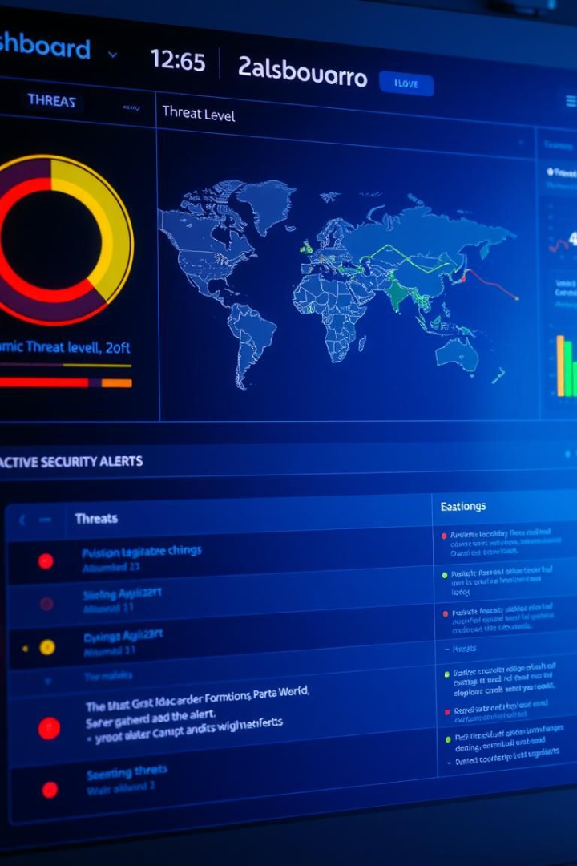




Results & Future Scope
Accuracy
Improved threat detection accuracy observed.
Response Time
Reduced incident response time noted.
Integration
Seamless integration with existing SIEM systems.
Future
AI-powered zero-trust and federated learning.

Slide 7
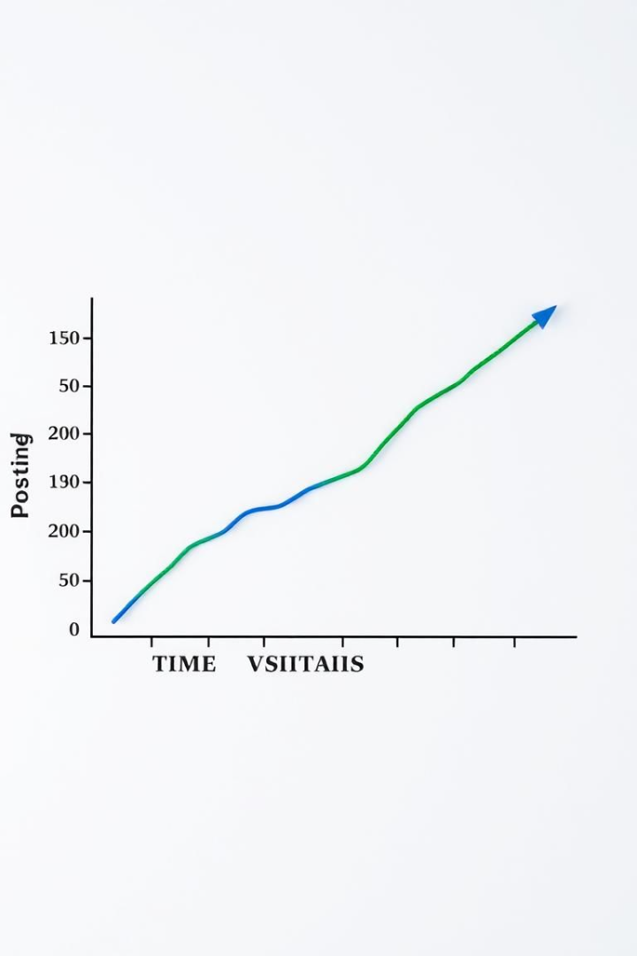
Quantifiable Improvements
95%
70%
Detection Rate
Faster Response
Increase in threat detection.
Reduced response time.
40%
Less Human Error
Reduction in error.

Slide 8

Key Takeaways
AI Enhances Security
Automation Is Critical
AI provides superior threat detection.
Automation speeds up incident response.
Future-Proofing
Invest in adaptive AI for security.

